Slide 1
The Ghost

Slide 2
The people who made this game
Andrew (Art)
Gavin (Coding/Levels)
Kelsey (Levels and music/sounds)

Slide 3
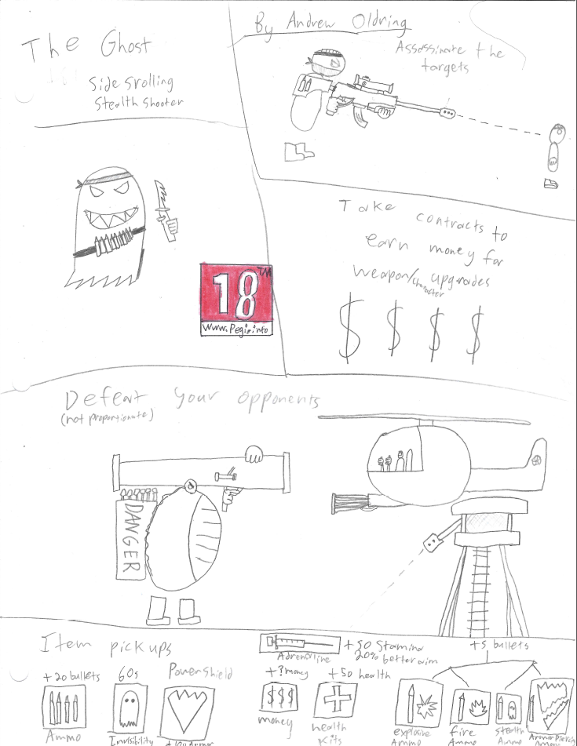
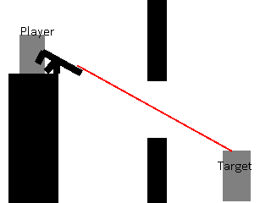
Original Idea
A stealthy sniper game
Upgradeable weapons
Bosses
Etc.

Slide 4
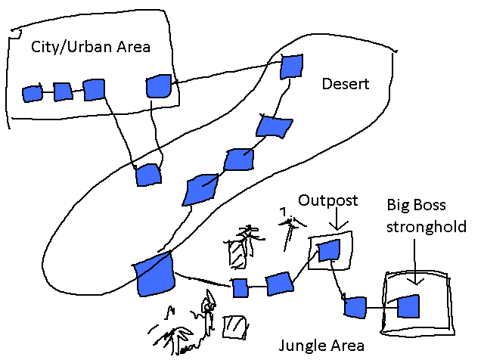
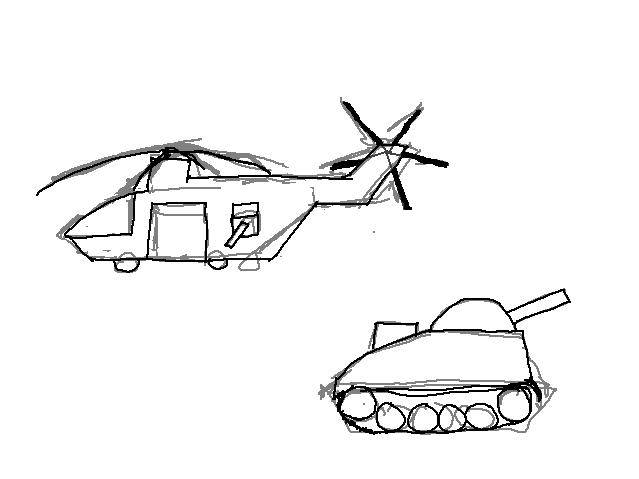
What we did not make
Bosses
Upgradeable weapons
A job board between levels
Over world map
Fire
Resolution
switching

Slide 5
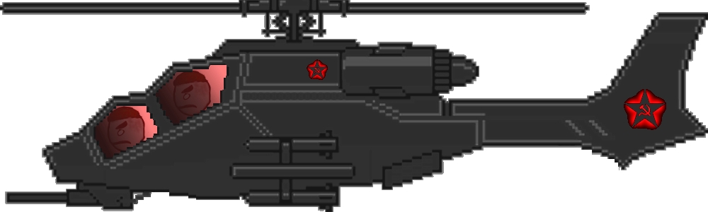
Why those things didn’t happen
Time
Priority
Theme

Slide 6
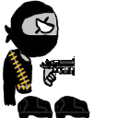
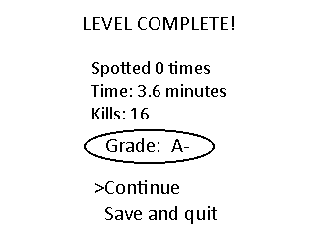
What we did make
Weapons
Stealth (sort of)
Levels
No grading, but high-scores
AI (with pathfinding)

Slide 7
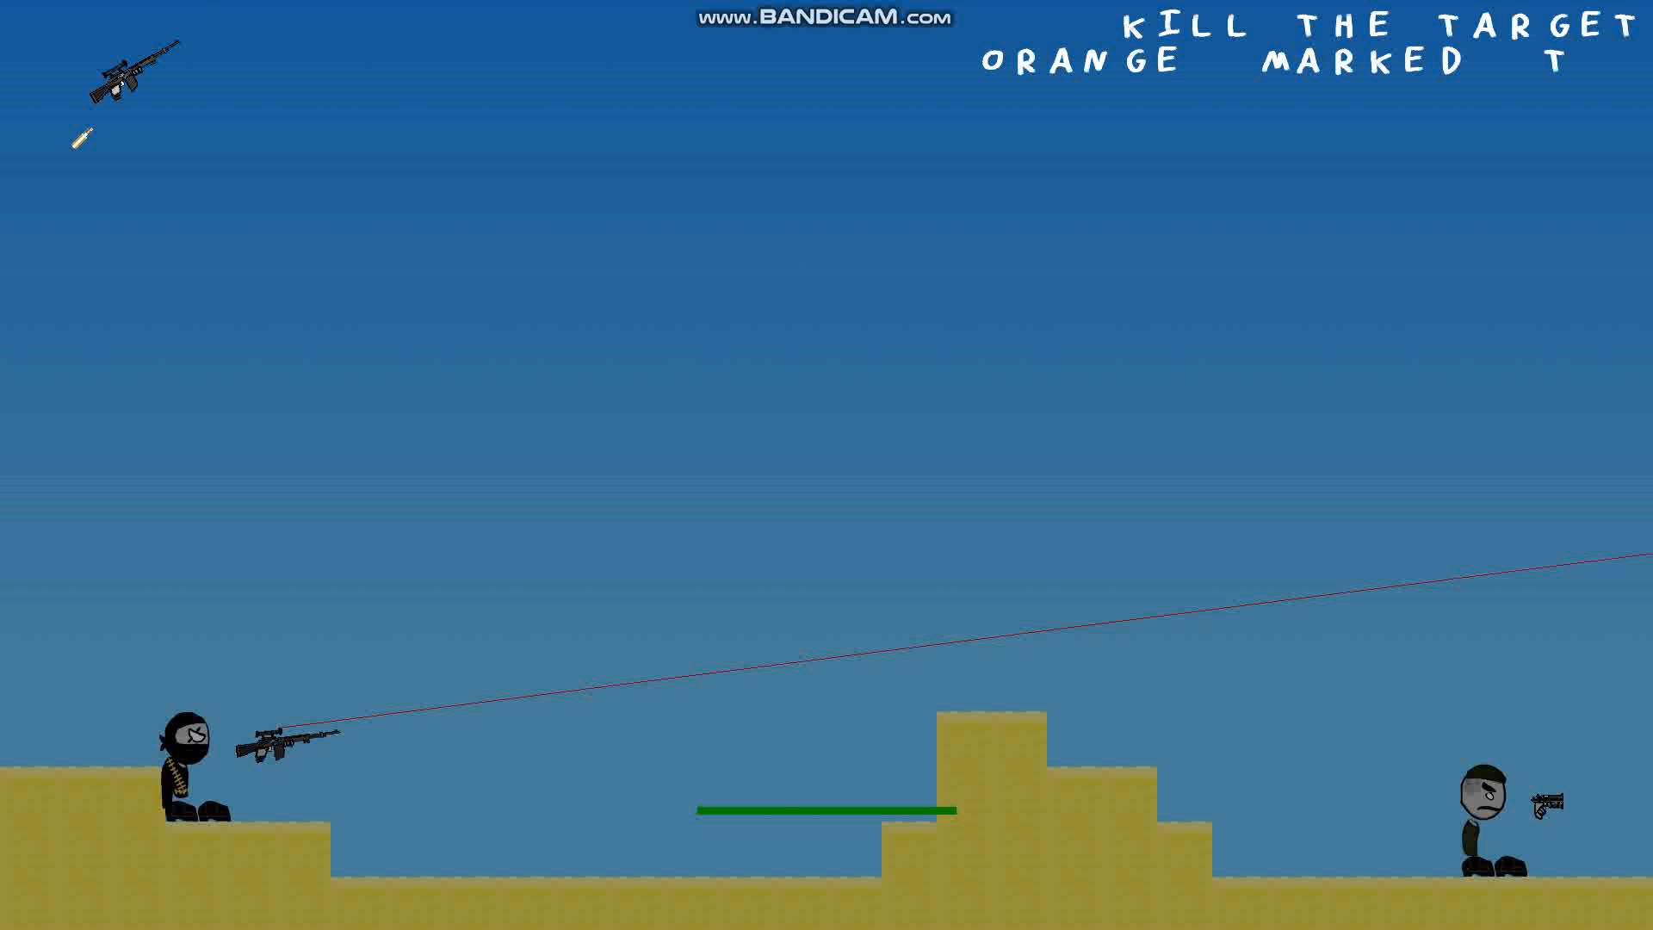
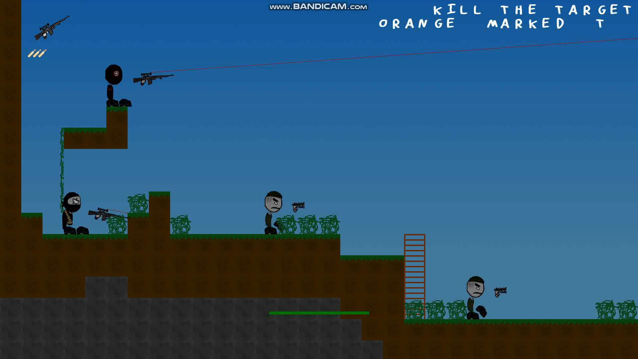
Level Demos
Desert
Jungle

Slide 8
What went well
Good start
Strong finish
Varied levels

Slide 9

What did not go well
Wasted time on pathfinding
Not many levels
Inconsistent difficulty
Not much variety in enemies
Buggy AI
Source control

